Slide 1

SYNAPSE - SOCIAL MEDIA WEB APPLICATION USING DJANGO
A production-minded full-stack social platform built with Django. Designed to be secure, scalable, and user-friendly — combining modern social features (posts, likes, comments, profiles) with strong authentication, data protection, and maintainable architecture modeled after industry practice.
Presented By - Rajveer Singh (12317715), Haris(12319805), Nashit(12313603), Samad(12319149)

Slide 2

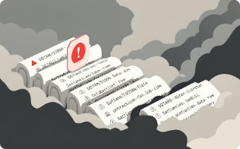

PROBLEM STATEMENT
AUTHENTICATION RISKS
DATA PROTECTION GAPS
SCALABILITY & UX
Many beginner apps use weak login flows, exposing accounts to brute-force and credential stuffing attacks.
Social features must be responsive and resilient under load while preserving security controls.
Improper handling of sensitive data (unencrypted secrets, missing validation) risks user privacy and compliance.
This project demonstrates a secure reference implementation addressing these gaps: hardened auth, access controls, safe data handling, and modern interactive UX.

Slide 3

PROJECT OBJECTIVES
SECURE AUTHENTICATION
AUTHORIZATION & ACCESS CONTROL
Implement email verification, MFA, brute-force protection, and safe password workflows.
Role-aware endpoints, per-object permissions for posts and profiles.
INTERACTIVE SOCIAL FEATURES
SCALABLE ARCHITECTURE
Create/like/comment flows with responsive updates (AJAX) and optimistic UI patterns.
Django MVT separation, modular apps, and database indexing for performance.

Slide 4
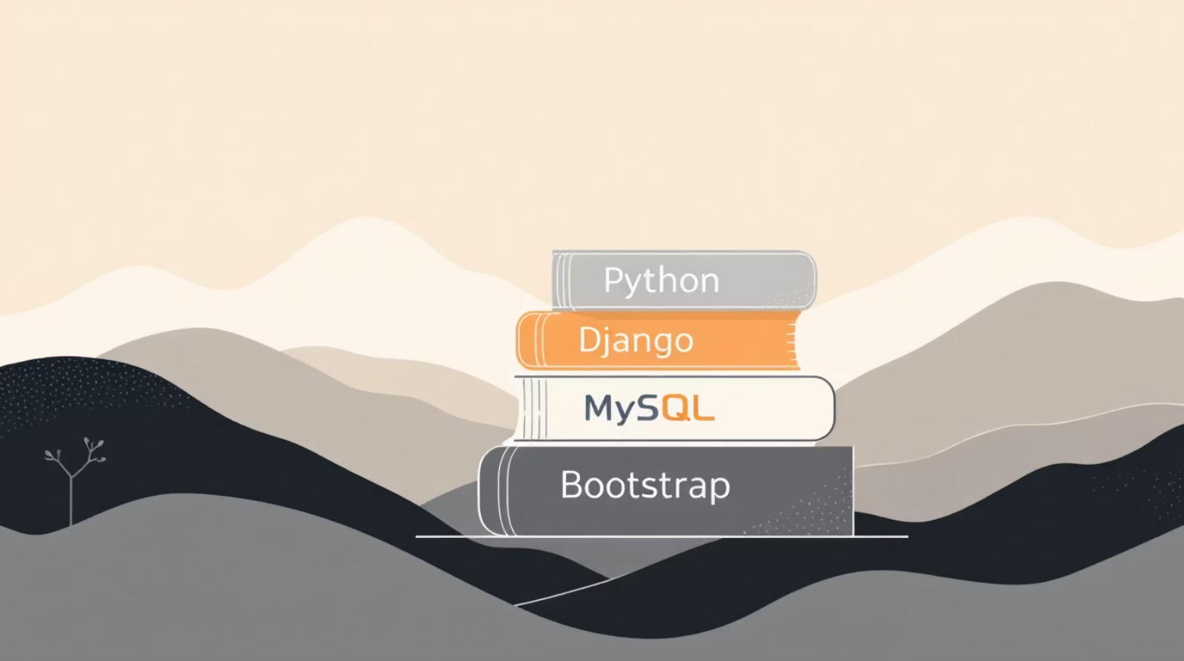
TECHNOLOGY STACK
BACKEND
Python 3.10+ with Django framework — clear URL routing, models, and reusable apps.
DATABASE
MySQL with careful schema design, indices for feed queries, and migrations for schema control.
SECURITY
Django auth + django-axes (brute-force protection), PyOTP for TOTP 2FA, python-dotenv for secrets.
FRONTEND
HTML, CSS, Bootstrap for responsive UI; AJAX for like/comment interactions and partial updates.

Slide 5

USER REQUEST
URL ROUTING
VIEW LOGIC
MODEL & DB
System architecture follows Django's MVT pattern. Clear separation of concerns keeps business logic in views, data in models, and presentation in templates — simplifying testing, maintenance, and horizontal scaling.

Slide 6
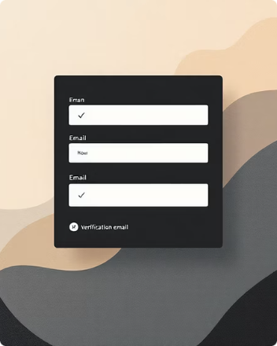
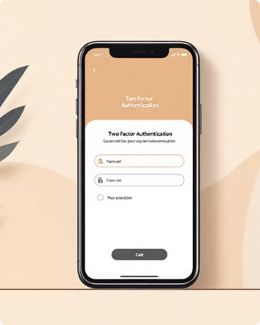


KEY FEATURES (SECURITY-FIRST)
REGISTRATION & EMAIL VERIFICATION
TWO-FACTOR AUTHENTICATION
BRUTE-FORCE PROTECTION
SECURE PASSWORD RESET
Optional TOTP (PyOTP) for stronger account protection; backup codes and enforced re-auth for sensitive actions.
django-axes integration limits failed attempts, locks risky IPs, and logs incidents for monitoring.
Time-limited tokens, one-time use, and email confirmation to reduce account takeover risk.
Account activation via tokenized email links to prevent fake accounts and enforce contactability.

Slide 7

USER WORKFLOW
1. REGISTER & VERIFY
User signs up, receives activation email, optionally enables 2FA.
2. AUTHENTICATE SECURELY
Login with username/email, TOTP 2FA if enabled, monitoring for suspicious attempts.
3. CREATE CONTENT
Upload images, add captions, saved via transactional model operations to avoid partial writes.
4. INTERACT IN FEED
Likes and comments update via AJAX; optimistic UI keeps the experience snappy while server confirms changes.
Profiles, feed ranking, and privacy controls allow users to manage visibility and interactions while the platform enforces secure defaults.

Slide 8

CHALLENGES & SOLUTIONS
DATABASE STABILITY
DYNAMIC LIKES
Issue: slow or inconsistent like counts. Fix: incremental counters, database transactions, and AJAX endpoints with idempotent updates.
Issue: connections failed after shutdown. Fix: robust MySQL config, connection pooling, and documented migration steps.
SECURITY
UI CONSISTENCY
Issue: brute-force attempts. Fix: integrated django-axes, rate limiting, logging, and alerting for anomalous behavior.
Issue: inconsistent post cards. Fix: standardized card component, responsive CSS, and server-side rendering for initial page load.

Slide 9

LEARNING OUTCOMES
PRACTICAL DJANGO DEVELOPMENT
Hands-on experience structuring apps, writing migrations, and building RESTful views and templates.
SECURE AUTH DESIGN
Implemented email verification, TOTP 2FA, secure password flows, and integrated middleware to mitigate attacks.
OPERATIONAL READINESS
Database tuning, clear deployment steps, environment variable management, and error handling improved reliability.
COLLABORATION & TOOLING
Used GitHub for version control, code reviews, and CI-friendly workflows to support team development.

Slide 10

CONCLUSION & NEXT STEPS
The project demonstrates a secure, scalable social media reference built with Django. Next steps: add rate-limited APIs, CI/CD with security scans, automated tests for auth flows, performance profiling, and deployment hardening (HTTPS, HSTS, secrets management).
DEPLOY
Containerize, add TLS, and stage rollout with monitoring.
HARDEN
Pen-test, secret rotation, and 3rd-party dependency auditing.
SCALE
Optimize queries, caching for feeds, and prepare horizontal scaling strategies.

